Slide 1

PYTHON Programming
24MCAGL107 – I SEM MCA – 2024-2025
Prof. Sheela D V
Assistant Professor

Slide 2
Course Objectives
To learn how to design and develop basic Python programs, and to apply the methods to create and manipulate the data structures such as strings, lists, tuples, dictionaries and arrays.
Develop modular programs using functions.
Demonstrate object- oriented concepts and understand the regular expressions.
State the need for Python Programming and provide real life examples.
Acquire the knowledge about Django Architecture with python.

Slide 3
Module 2: Python Functions
Python Functions: Defining functions – DOC strings – function Parameters: Default, keyword required and variable length arguments, key-word only parameters – local and global variables – pass by reference versus value – recursion – Functional Programming: Mapping – filtering and reduction – Lambda functions – list comprehensions.

Slide 4
Function in Python
Python Functions is a block of statements that return the specific task. The idea is to put some commonly or repeatedly done tasks together and make a function so that instead of writing the same code again and again for different inputs, we can do the function calls to reuse code contained in it repeatedly.
A function is a reusable block of code that performs a specific task. Functions help to organize your code into manageable, modular sections, making it easier to read, debug, and maintain.
Some Benefits of Using Functions
Increase Code Readability
Increase Code Reusability

Slide 5
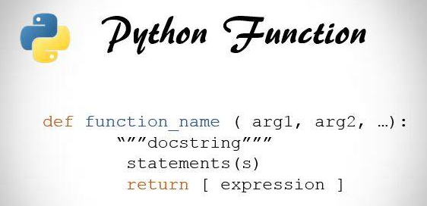
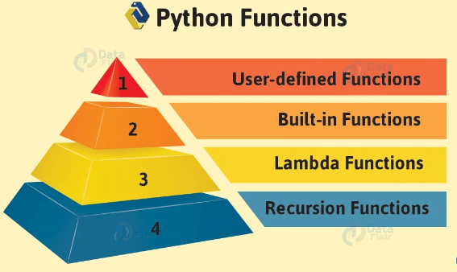
Functions declaration and types in Python

Slide 6
Example
In this example:
def is the keyword used to define a function.greet is the name of the function.
(name) is the parameter the function takes.
The code inside the function (in this case, print(f"Hello, {name}!")) is what the function does.
The function is called with greet("Alice"), which outputs: Hello, Alice!.
def greet(name):
print(f"Hello, {name}!")
greet("Alice")

Slide 7
Example
def add(a, b):
return a + b
result = add(3, 5)
print(result)
# Output: 8
add function takes two parameters, a and b, adds them, and returns the result.

Slide 8
example
# Main part of the program
def main():
# Call the add_numbers function
sum_result = add_numbers(10, 5)
print("Sum: ", sum_result)
# Call the subtract_numbers function
difference_result = subtract_numbers(10, 5)
print("Difference: ", difference_result)
# Call the multiply_numbers function
product_result = multiply_numbers(10, 5)
print("Product: ", product_result)
# Call the divide_numbers function
division_result = divide_numbers(10, 5)
print("Division: ", division_result)
# Attempting division by zero
division_by_zero_result = divide_numbers(10, 0)
print("Division by Zero: ", division_by_zero_result)
# Call the main function to execute the program
main()
# Define a function that adds two numbers
def add_numbers(num1, num2):
return num1 + num2
# Define a function that subtracts two numbers
def subtract_numbers(num1, num2):
return num1 - num2
# Define a function that multiplies two numbers
def multiply_numbers(num1, num2):
return num1 * num2
# Define a function that divides two numbers
def divide_numbers(num1, num2):
if num2 == 0:
return "Error: Division by zero is not allowed"
else:
return num1 / num2

Slide 9
Output
Sum: 15
Difference: 5
Product: 50
Division: 2.0
Division by Zero: Error: Division by zero is not allowed
This example illustrates how functions are defined, called, and used to perform basic arithmetic operations.

Slide 10
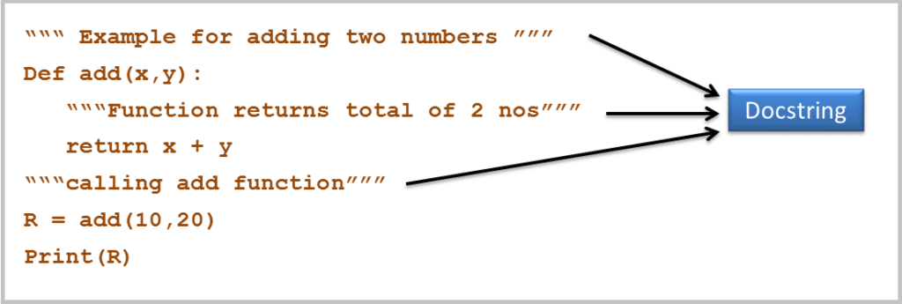
Docstring in python
A docstring in Python is a string that describes the functionality of a function, class, or module. It is placed right below the function definition and is used to document what the function does, its parameters, and what it returns. Docstrings help other developers (or yourself) understand the purpose of the function and how to use it without needing to look at the implementation.

Slide 11
Contd…
In Python, docstrings are written using triple quotes (""" or '''), which allow the string to span multiple lines. The syntax and conventions for writing docstrings are standardized, although Python allows some flexibility.

Slide 12
Contd…
Triple Quotes (""" or '''): Use triple quotes to define a docstring.
Short Description: The first line should provide a brief summary of what the function does.
Blank Line: After the summary, leave a blank line if you plan to add more detailed information.
Detailed Description (optional): You can add further explanation of the function’s purpose or behavior, if necessary.
Parameters Section (optional): Document each parameter, including its type and description. This is especially useful for more complex functions with multiple arguments.
Returns Section (optional): Document what the function returns, including the return type. This is particularly useful if the function returns a value.
def function_name(parameters):
“ “ “
A short description of what the function does.
A more detailed explanation of the function’s behavior (optional).
Parameters:
parameter_name (type): Description of the parameter.
Returns:
return_type: Description of what is returned (optional).
“ “ “
# Function body

Slide 13
Example
def divide(numerator, denominator):
"""
Divides the numerator by the denominator and returns the result.
If the denominator is zero, an error message is returned instead.
Parameters:
numerator (int or float): The number to be divided.
denominator (int or float): The number by which to divide the numerator.
Returns:
float: The result of the division if the denominator is non-zero.
str: An error message if the denominator is zero.
"""
if denominator == 0:
return "Error: Cannot divide by zero."
return numerator / denominator
def multiply(a, b):
"""
Multiplies two numbers and returns the result.
Parameters:
a (int or float): The first number to be multiplied.
b (int or float): The second number to be multiplied.
Returns:
int or float: The product of the two numbers.
"""
return a * b

Slide 14
example
class Calculator:
"""
A simple calculator class to perform basic arithmetic operations.
Methods:
add(a, b): Returns the sum of a and b.
subtract(a, b): Returns the difference of a and b.
multiply(a, b): Returns the product of a and b.
divide(a, b): Returns the result of a divided by b, or an error if division by zero.
"""
def add(self, a, b):
return a + b

Slide 15
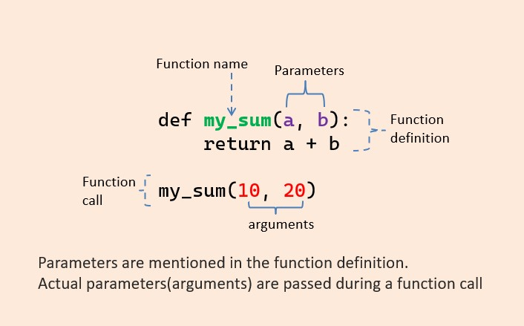
Function parameters and arguments
Parameter: A parameter is the variable listed inside the parentheses in the function definition.
Argument: An argument is the value that are sent to the function when it is called.

Slide 16
Function parameter: default
default parameters allow a function to have predefined values for its arguments. If a value is not provided when calling the function, the default value is used.
Syntax
def function_name(param1=default_value1, param2=default_value2):
# function body
Example:
def greet(name="Guest"):
print(f"Hello, {name}!")
greet("Alice") # Output: Hello, Alice!
greet() # Output: Hello, Guest!
f name is provided, it prints "Hello, Alice!“
If not, it defaults to "Guest".

Slide 17
Keyword Required Arguments (*)
Keyword required arguments must be passed by name when calling the function.
Syntax
def function_name(*, param1, param2):
# function body
Example
def greet(*, name, age):
print(f"Hello {name}, you are {age} years old.")
greet(name="Alice", age=25) # ✅ Correct
# greet("Alice", 25) # ❌ Error: Must use keywords
Arguments after * must be passed as keywords.

Slide 18
Variable-Length Arguments
Python allows functions to accept a variable number of arguments using *args and **kwargs.
a. *args (Non-keyword Variable Arguments)Used to pass a variable number of positional arguments.
def add_numbers(*args):
return sum(args)
print(add_numbers(1, 2, 3))
# Output: 6
print(add_numbers(4, 5, 6, 7))
# Output: 22

Slide 19
Contd…
b. **kwargs (Keyword Variable Arguments)Used to pass a variable number of keyword arguments.
def display_info(**kwargs):
for key, value in kwargs.items():
print(f"{key}: {value}")
display_info(name="Alice", age=25, city="New York")

Slide 20
Example
def mixed_func(a, b=2, *args, c, **kwargs):
print(f"a = {a}")
print(f"b = {b}")
print(f"args = {args}")
print(f"c = {c}")
print(f"kwargs = {kwargs}")
mixed_func(1, 3, 4, 5, c=6, d=7, e=8)
Output
a = 1
b = 3
args = (4, 5)
c = 6
kwargs = {'d': 7, 'e': 8}

Slide 21
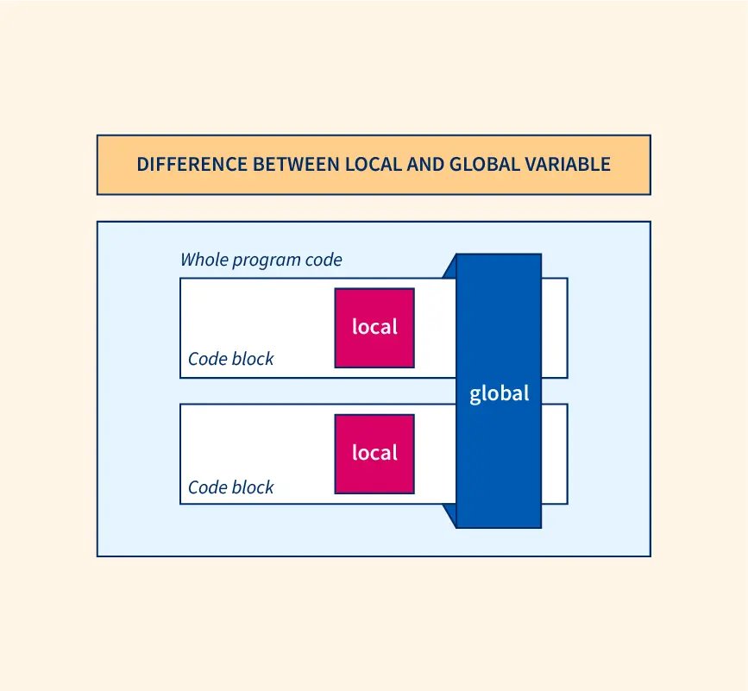
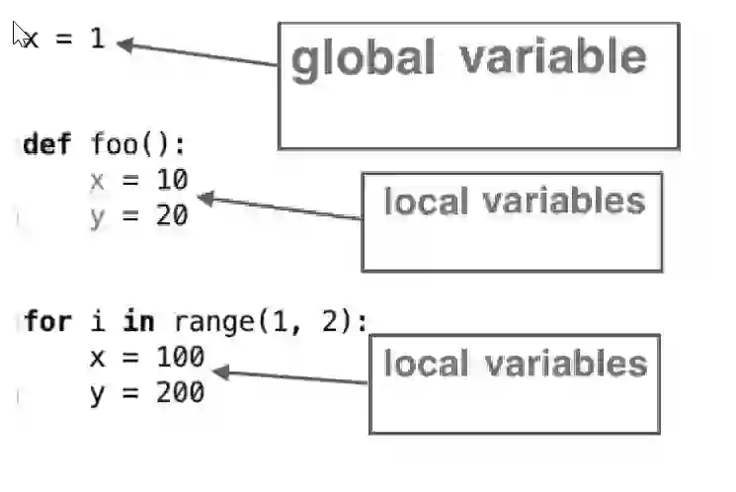
Global and local variable

Slide 22
cont..
Local variables in Python are those which are initialized inside a function and belong only to that particular function. It cannot be accessed anywhere outside the function. Let’s see how to create a local variable.
Global variables are those which are defined outside any function, and which are accessible throughout the program, i.e., inside and outside of every function.

Slide 23
Example
# Global variable
x = 10
def example_function():
# Local variable
y = 5
print("Inside function:")
print("Local variable y:", y) # Local variable
print("Global variable x:", x) # Global variable can be accessed inside the function
def modify_global():
global x # This allows us to modify the global variable 'x'
print("Before modifying, global x =", x)
x = 20 # Modifying global variable
print("After modifying, global x =", x)
def another_function():
# Accessing global variable directly
print("Inside another_function, global x:", x)
# Main program
print("In main program, global x:", x)
example_function()
# Modify the global variable using a function
modify_global()
# Access the modified global variable
another_function()
# After modification, the global variable is updated
print("In main program, global x after modification:", x)

Slide 24
Contd…
1. Global Variable (x):
x is defined outside any function, making it a global variable. It is accessible in all functions, but it can be modified inside a function only if you declare it as global using the global keyword.
2. Local Variable (y):
y is defined inside the example_function and can only be accessed within that function. It is not accessible outside of the function.
3. Modifying a Global Variable:
The modify_global() function shows how to modify a global variable inside a function using the global keyword.
Without the global keyword, trying to assign a value to x inside the function would create a new local variable x, and it would not affect the global x.
Output
In main program, global x: 10
Inside function:
Local variable y: 5
Global variable x: 10
Before modifying, global x = 10
After modifying, global x = 20
Inside another_function, global x: 20
In main program, global x after modification: 20

Slide 25
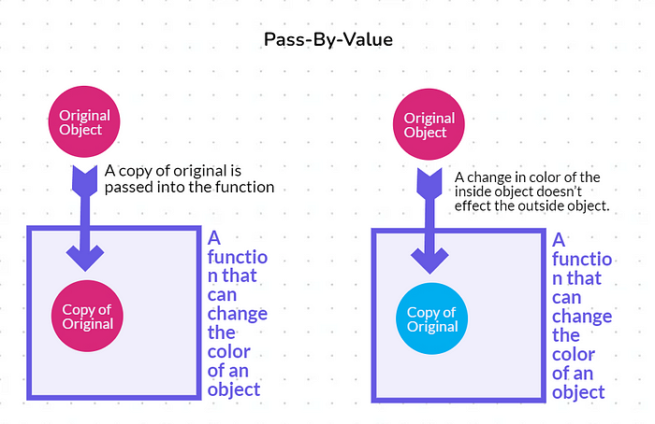
Pass by value and pass by reference
Pass by value: In a pass by value system, a copy of the data (such as a variable's value) is passed to a function or assigned to another variable. Any changes made to the copy do not affect the original data.

Slide 26
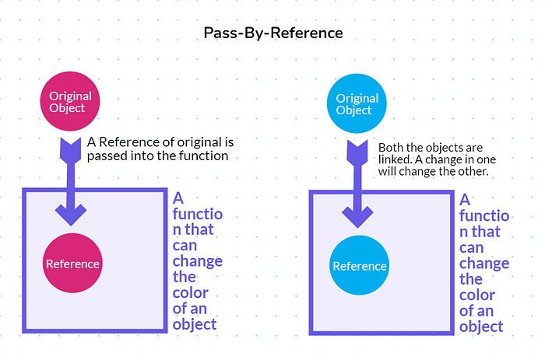
Cont..
Pass by reference: In contrast, pass by reference involves passing a reference to the original data or object rather than a copy. Any changes made to the referenced object inside a function or operation are reflected in the original object.

Slide 27
Contd…
In Python, pass by value is not strictly applicable in the way it is in other languages like C or Java, since Python uses pass by reference for both mutable and immutable objects.
However, it can simulate "pass by value" behavior with immutable objects like integers, strings, and tuples, because they cannot be modified in place.
When you pass an immutable object to a function, the object itself cannot be changed; only a new reference to an object can be created.

Slide 28
Immutable Objects (e.g., integers, strings, tuples)
def modify_value(x):
x = 10 # This creates a new integer object, does not affect the original one
a = 5
modify_value(a)
print(a) # Output: 5
In the example, the integer a is passed to the function, but since integers are immutable, any modification to x inside the function does not affect a.
For immutable objects, it behaves similarly to "pass by value" in other languages. Since the object cannot be changed in place, any modification within the function results in the creation of a new object.

Slide 29
Mutable Objects (e.g., lists, dictionaries, sets)
def modify_list(lst):
lst.append(4) # This modifies the original list
my_list = [1, 2, 3]
modify_list(my_list)
print(my_list) # Output: [1, 2, 3, 4] (the original list is modified)
For mutable objects, changes made inside the function will affect the original object because the reference to the object is passed.
Since lists are mutable, the modify_list function changes the original list.

Slide 30
Built in functions in python
The built-in Python functions are pre-defined by the python interpreter.
These functions perform a specific task and can be used in any program, depending on the requirement of the user.
There are 68 built-in python functions in Python.

Slide 31
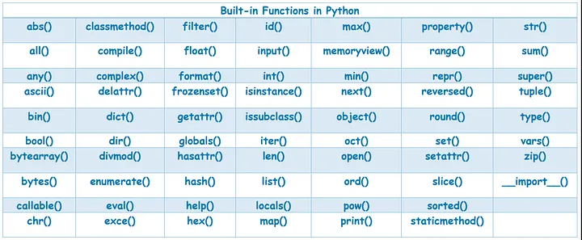
Cont..

Slide 32
User defined functions in python
A user-defined function is a function that is written and defined by the programmer to perform specific tasks or calculations.
Below are the steps for writing user-defined functions in Python.
In Python, a def keyword is used to declare user-defined functions.
An indented block of statements follows the function name and arguments which contains the body of the function.
Syntax:
def function_name():
statements

Slide 33
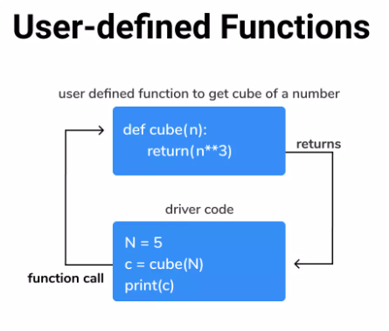
Cont..

Slide 34
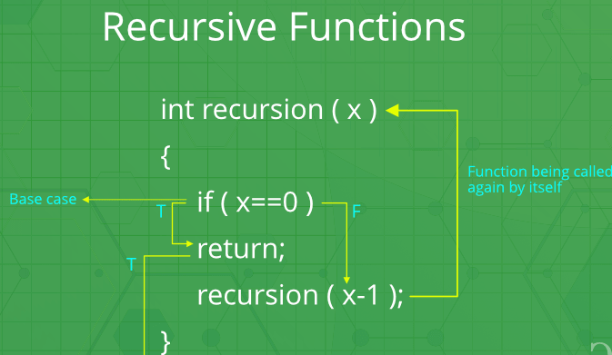
Recursion functions
Recursive functions are functions that calls itself. It is always made up of 2 portions, the base case and the recursive case. The base case is the condition to stop the recursion. The recursive case is the part where the function calls on itself.

Slide 35
Example of a Recursive Function: Factorial
def factorial(n):
# Base case
if n == 0:
return 1
# Recursive case
else:
return n * factorial(n - 1)
# Testing the function
print(factorial(5)) # Output: 120
The base case is when n == 0, at which point the function returns 1 because 0! = 1.
The recursive case is where the function calls itself with n-1, multiplying the result of the recursive call by n.

Slide 36
How recursion works step by step
For factorial(5):
factorial(5) calls factorial(4)
factorial(4) calls factorial(3)
factorial(3) calls factorial(2)
factorial(2) calls factorial(1)
factorial(1) calls factorial(0)
factorial(0) returns 1
factorial(1) returns 1 * 1 = 1
factorial(2) returns 2 * 1 = 2
factorial(3) returns 3 * 2 = 6
factorial(4) returns 4 * 6 = 24
factorial(5) returns 5 * 24 = 120
Thus, factorial(5) returns 120.

Slide 37
Functional Programming in Python
Functional programming is a programming paradigm in which we try to bind everything in a pure mathematical functions style.
It is a declarative type of programming style. Its main focus is on ” what to solve” in contrast to an imperative style where the main focus is “how to solve“.
It uses expressions instead of statements. An expression is evaluated to produce a value whereas a statement is executed to assign variables.

Slide 38
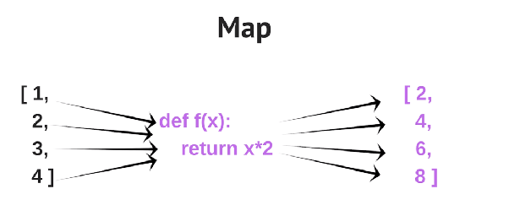
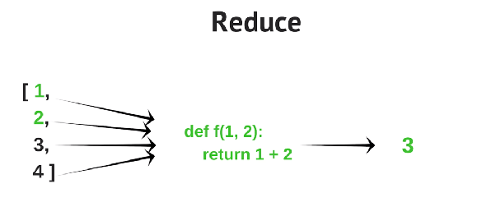
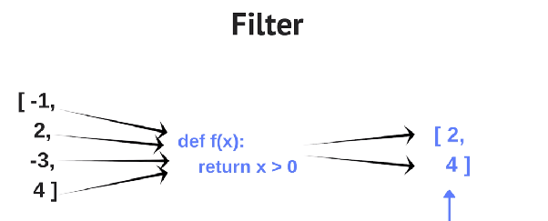
Map –reduce-filter in python

Slide 39
Map - Filter - Reduce
The 'Map' operation in programming transforms data from one form into another.
The 'Reduce' operation combines the elements of a list into a single result.
The 'Filter' operation selects a subset of items based on a given condition.

Slide 40
Mapping
Mapping refers to applying a function to each item in an iterable (like a list, tuple, or other collections).
The most common way to achieve this in Python is using the map() function.
map() Function - The map() function applies a given function to each item in an iterable (such as a list, tuple, etc.) and returns an iterator of the results.
Syntax
map(function, iterable, ...)
function: A function that will be applied to each item of the iterable(s).
iterable: One or more iterables (e.g., list, tuple, etc.) whose elements will be passed to the function.

Slide 41
Example
# Function to square a number
def square(x):
return x * x
# List of numbers
numbers = [1, 2, 3, 4, 5]
# Applying the function to each element in the list using map
squared_numbers = map(square, numbers)
# Converting the map object to a list and printing it
print(list(squared_numbers))
Output
[1, 4, 9, 16, 25]
The square() function is applied to each number in the numbers list, and the result is returned as an iterator that is converted to a list for display.

Slide 42
Filtering
Filtering refers to the process of selecting elements from an iterable (like a list, tuple, or string) based on a condition.
The filter() function is used to filter elements of an iterable based on a given function that defines the condition.
Syntax:
filter(function, iterable)
function: A function that defines the condition to filter elements. This function should return True or False for each element of the iterable.
iterable: The iterable (like a list, tuple, etc.) whose elements will be checked by the function.

Slide 43
Examples
# Function to check if a number is even
def is_even(x):
return x % 2 == 0
# List of numbers
numbers = [1, 2, 3, 4, 5, 6, 7, 8, 9, 10]
# Using filter to get even numbers
even_numbers = filter(is_even, numbers)
# Converting the filter object to a list and printing
print(list(even_numbers)) # Output: [2, 4, 6, 8, 10]
Filtering Strings by Length:
# List of strings
words = ["apple", "banana", "cherry", "date", "elderberry"]
# Filtering words with length greater than 5
long_words = filter(lambda word: len(word) > 5, words)
# Converting the filter object to a list and printing
print(list(long_words)) # Output: ['banana', 'cherry', 'elderberry']

Slide 44
Example
Filtering with Multiple Conditions:
# List of numbers
numbers = [1, 2, 3, 4, 5, 6, 7, 8, 9, 10]
# Filter even numbers greater than 5
even_and_greater_than_five = filter(lambda x: x % 2 == 0 and x > 5, numbers)
# Converting the filter object to a list and printing
print(list(even_and_greater_than_five)) # Output: [6, 8, 10]

Slide 45
Reduction
Reduction refers to the process of applying a function cumulatively to the items of an iterable (e.g., a list, tuple) to reduce the iterable to a single value.
The most common function used for reduction is functools.reduce(). The reduce() function repeatedly applies a binary function to the elements of an iterable.
Syntax
from functools import reduce
reduce(function, iterable, [initial])
function: A binary function (a function that takes two arguments) that will be applied to the elements of the iterable. The function must accept two arguments and return a single value.
iterable: The iterable whose elements will be reduced.
initial (optional): A starting value for the reduction. If not provided, the first element of the iterable is used as the initial value

Slide 46
Examples
Summing All Numbers in a List:
from functools import reduce
numbers = [1, 2, 3, 4, 5]
# Using reduce to sum all numbers
sum_result = reduce(lambda x, y: x + y, numbers)
print(sum_result) # Output: 15
Multiplying All Numbers in a List:
from functools import reduce
numbers = [1, 2, 3, 4, 5]
# Using reduce to multiply all numbers
product_result = reduce(lambda x, y: x * y, numbers)
print(product_result) # Output: 120

Slide 47
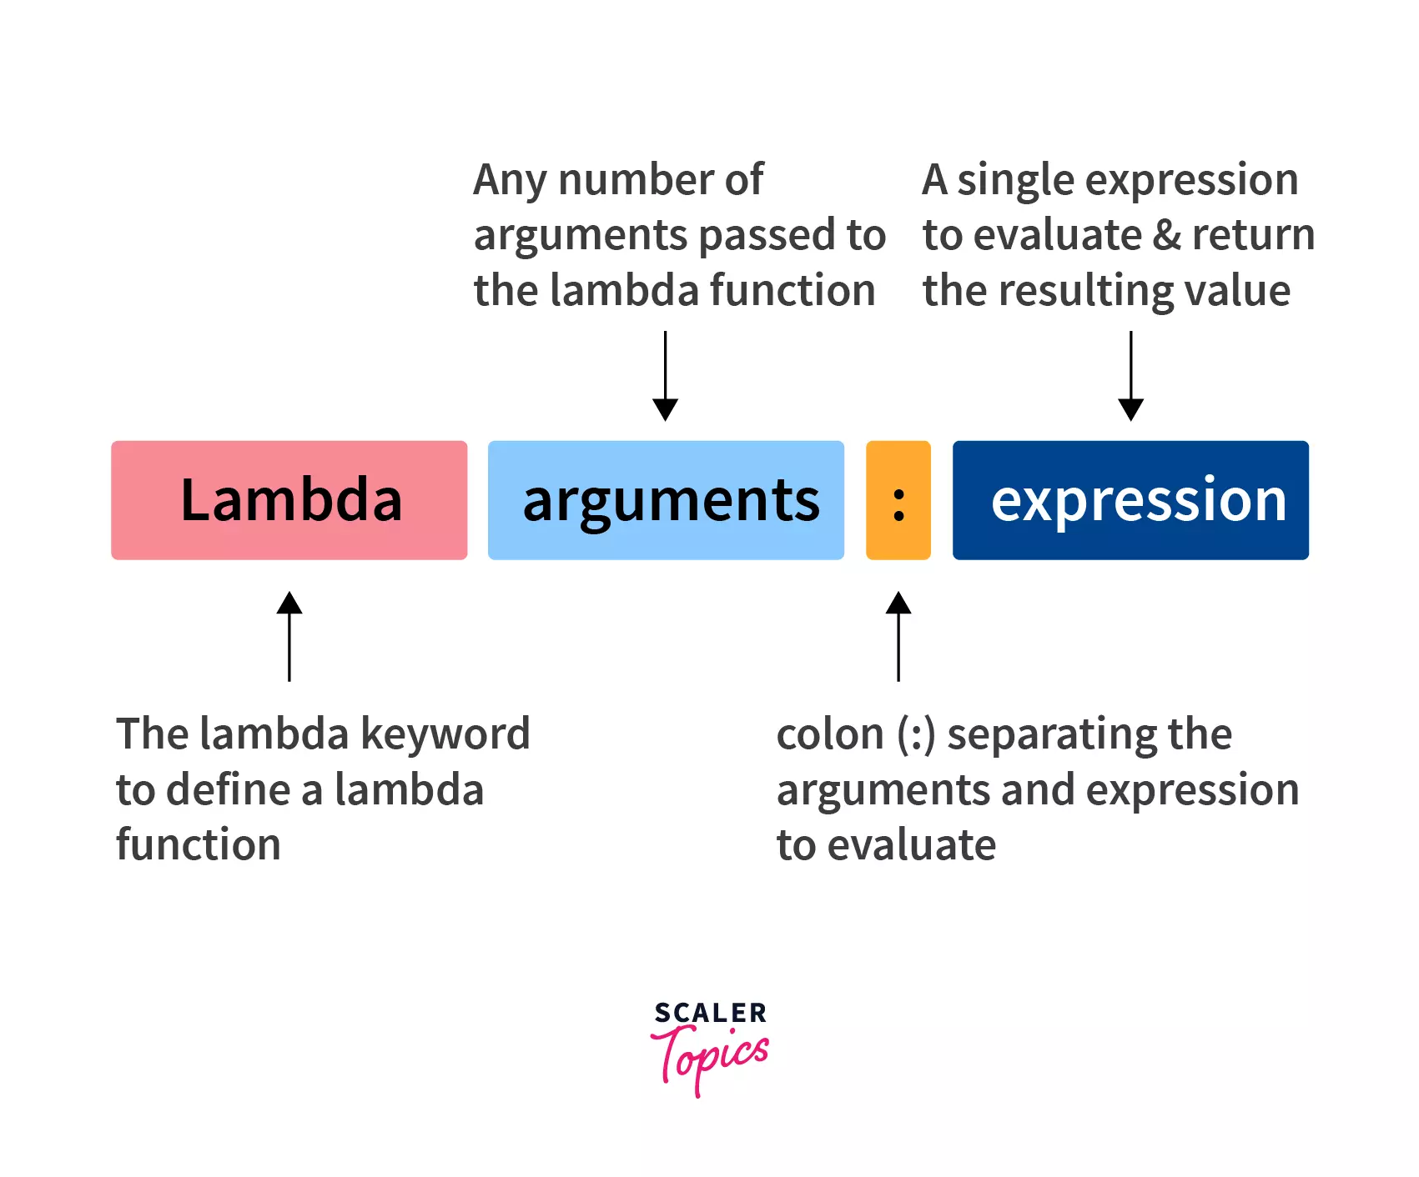
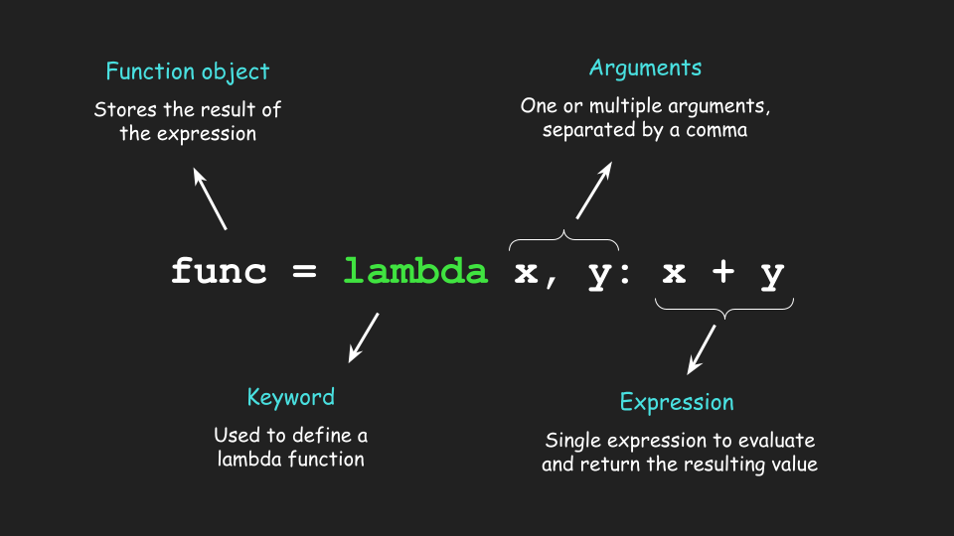
Lambda function(Function without name)

Slide 48
Contd…
lambda function in Python is a small, anonymous function defined using the lambda keyword.
Unlike regular functions that are defined using the def keyword, lambda functions are typically used for short, throwaway functions where defining a full function with def would be unnecessary.
Syntax
lambda arguments: expression
arguments: A comma-separated list of parameters (like the parameters of a regular function).
expression: A single expression that is evaluated and returned. The expression cannot contain multiple statements.

Slide 49
Contd…
Example
# Lambda function to add two numbers
add = lambda x, y: x + y
# Calling the lambda function
result = add(3, 5)
print(result) # Output: 8
Using lambda with map()
numbers = [1, 2, 3, 4, 5]
# Using lambda to square each number in the list
squared_numbers = map(lambda x: x * x, numbers)
# Converting map object to a list and printing
print(list(squared_numbers)) # Output: [1, 4, 9, 16, 25]

Slide 50
Contd…
Using a lambda with filter()
numbers = [1, 2, 3, 4, 5, 6]
# Using lambda to filter even numbers
even_numbers = filter(lambda x: x % 2 == 0, numbers)
# Converting filter object to a list and printing
print(list(even_numbers)) # Output: [2, 4, 6]
Lambda function with default arguments
# Lambda function with default argument
greet = lambda name="Guest": f"Hello, {name}!"
# Calling with a default value
print(greet()) # Output: Hello, Guest!
# Calling with a specific value
print(greet("Alice")) # Output: Hello, Alice!

Slide 51
Contd…
Advantages of Lambda Functions:
Concise: Lambda functions are useful for creating small, one-off functions without having to formally define them.
Inline Usage: They are particularly handy in situations where a function is needed temporarily, such as within map(), filter(), or sorted().
No Need for Full Definition: For simple functionality, lambda functions are more compact and readable than defining a full function with def.
Disadvantages:
Limited Functionality: Since lambda functions can only contain a single expression, they are not suitable for complex logic.
Readability: If overused or used for complex operations, lambda functions can reduce the readability of the code.

Slide 52
Contd…
When to Use Lambda Functions:
When you need a simple, short function for a specific task (like filtering or mapping).
When the function is only going to be used in a specific context and does not need to be reused.
When you want to pass a function as an argument to other functions like map(), filter(), or sorted().

Slide 53
List Comprehension in Python
List comprehension is a way to create lists using a concise syntax. It allows us to generate a new list by applying an expression to each item in an existing iterable (such as a list or range).
This helps us to write cleaner, more readable code compared to traditional looping techniques.
for loop vs. list comprehension
The main difference is that a for loop requires multiple lines to create a new list by iterating over items and manually adding each one. Whereas, list comprehension do the same task in a single line, this makes the code simpler and easier to read.

Slide 54
Contd…
Syntax of list comprehension
[expression for item in iterable if condition]
expression: The transformation or value to be included in the new list.
item: The current element taken from the iterable.
iterable: A sequence or collection (e.g., list, tuple, set).
if condition (optional): A filtering condition that decides whether the current item should be included.
Example:
a = [2,3,4,5]
res = [val ** 2 for val in a]
print(res)
Output
[4, 9, 16, 25]

Slide 55
Example
For loop
a = [1, 2, 3, 4, 5]
# Create an empty list 'res' to store results
res = []
# Iterate over each element in list 'a'
for val in a:
# Multiply each element by 2 and append it to 'res'
res.append(val * 2)
print(res)
List Comprehension
a = [1, 2, 3, 4, 5]
res = [val * 2 for val in a]
print(res)

Slide 56
Conditional expression in list comprehension
numbers = [x if x % 2 == 0 else 'odd' for x in range(5)]
print(numbers)
# Output: [0, 'odd', 2, 'odd', 4]

